Slide 1
Value of biodiversity
Survival
Ecological Services and economic value
Health and Healing
Productive Value and food security
Ethical and Aesthetic
pleasure

Slide 2
BIODIVERSITY VALUE AND SERVICES
The multiple uses of biodiversity has been classified by McNeely et al.(1990) as follows:
Consumptive use value: Based on direct consumption.
Productive use value: Based on product use.
Social value: Based on socio-cultural use.
Ethical value: Based on the ethics of existence.
Aesthetic value: Based on aesthetics.
Option value: Based on some unknown utility that is to be explored.
Ecosystem service value: Based on valuation of various ecosystem functions.
Environmental Studies ©New age International Pvt Ltd

Slide 3
Conservation of biodiversity
Biodiversity conservation is the scientific management at its optimum level and derives sustainable benefit for both the present and the future.
There are two major approaches for conservation of biodiversity – in situ (on site) and ex situ (off site).

Slide 4
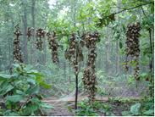
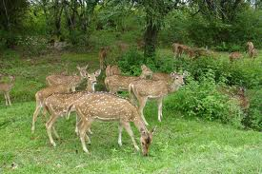
In situ conservation – In situ means the natural or the original place. In situ conservation includes National parks, Wildlife sanctuaries, Biosphere reserves, etc.

Slide 5
In situ conservation
National parks – Corbett national park in nainital
Wildlife sanctuary – Sariska tiger reserve, periyar
Biosphere reserves - Nilgiri, nanda devi, sunderbans

Slide 6
BIODIVERSITY CONSERVATION
In situ conservation (within habitat):
e.g. Biosphere Reserves, National Parks, Sanctuaries, Reserve Forests etc.
Ex situ conservation (outside habitat):
e.g. gene banks, seed banks, zoos, botanical gardens, culture collections etc.
A. In situ conservation
Biosphere Reserves conserve some representative ecosystems as a whole for long-term in situ conservation.
e.g. Nanda Devi (U.P.), Nokrek (Meghalaya), Manas (Assam), Sunderbans (West Bengal), Gulf of Mannar (Tamil Nadu), Nilgiri (Karnataka, Kerala, Tamil Nadu), Great Nicobars and Similipal (Orrisa) biosphere reserve
National Park is an area dedicated to conservation of wildlife along with its environment
Wildlife Sanctuary is protected area where killing, hunting or capturing of wildlife is prohibited.
Environmental Studies ©New age International Pvt Ltd

Slide 7
B) EX SITU CONSERVATION
In India following are the important gene bank/seed bank facilities:
National Bureau of Plant Genetic Resources (NBPGR) in New Delhi
National Bureau of Animal Genetic Resources (NBAGR) at Karnal, Haryana
National Facility for Plant Tissue Culture Repository (NFPTCR).
Environmental Studies ©New age International Pvt Ltd

Slide 8
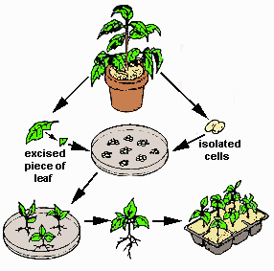
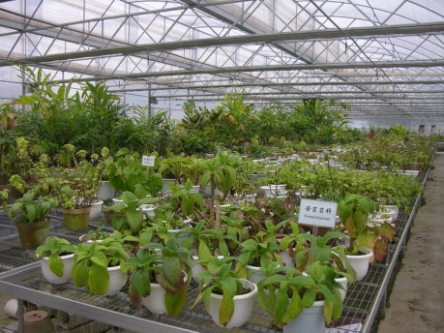
Ex situ conservation – In this technique, plant and animal species are conserved outside their natural habitats. Ex situ conservation is the chief mode of preservation of genetic resources. This can be done through establishment of gene banks, zoos, botanical gardens, culture collections, etc.

Slide 9
Ex situ conservation
Gene bank
Botanical Gardens
Aquaria
Tissue culture technique
DNA technology

Slide 10
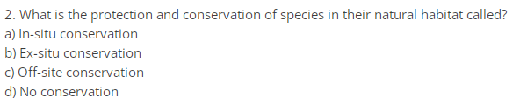

Slide 11
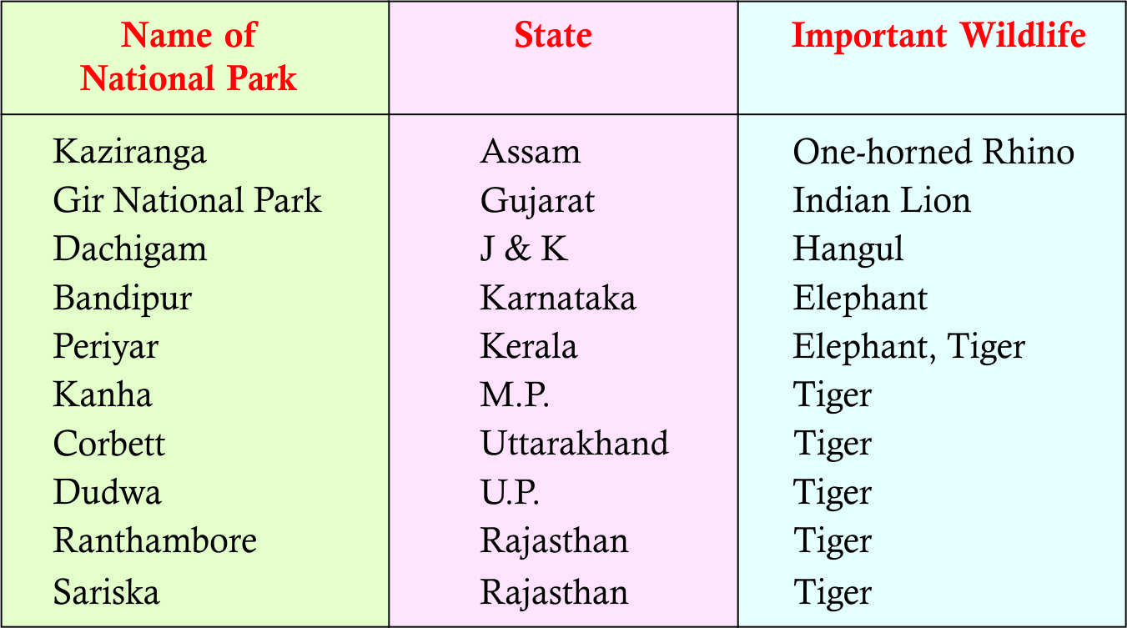
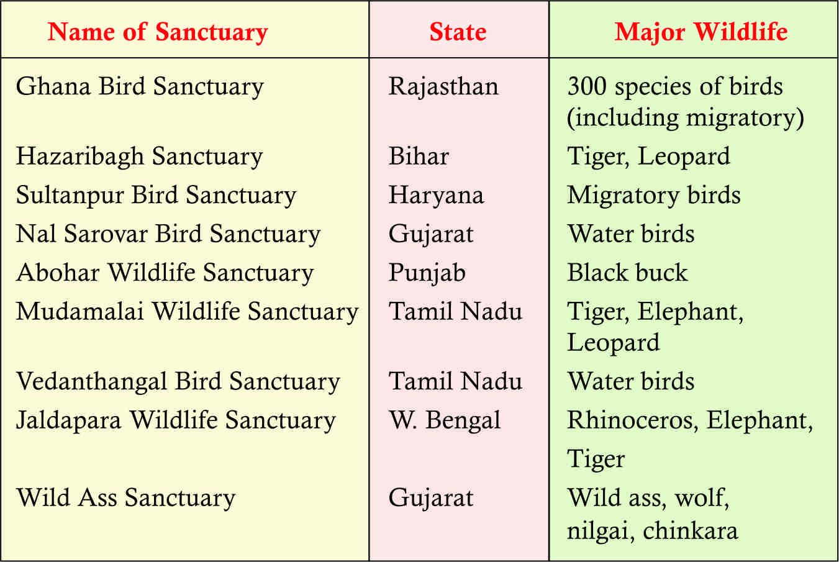
Some important National Parks and Sanctuaries of India
National Parks
Wild life Sanctuaries
Environmental Studies ©New age International Pvt Ltd

Slide 12
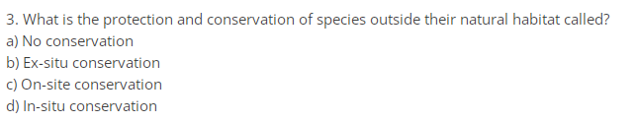

Slide 13
 | Objectives | Features | Zone
National Parks | Conservation of species of a habitat with minimal or very low intensity of human activities | No person resides in the park other than public servants on duty and persons permitted by the chief wildlife warden | Core
Wildlife Sanctuary | Conservation of species and habitats by manipulative management | No person resides in the park other than public servants on duty and persons permitted by the chief wildlife warden | Core, Buffer and Restoration
Biosphere Reserves | Conservation of natural resources and the improvement of the relationship between humans and the environment | Both natural and human-influenced ecosystems; substantial human settlement | Core, Buffer, Restoration and Transition

Slide 14
Core zone:- Undisturbed and legally protected ecosystem
Buffer zone:- It surrounds the core area and it’s dedicated to research and educational activity
Transition zone:- Outer most region where inhabitation, agriculture, recreational activity occur.

Slide 15
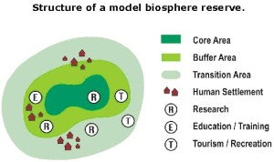

Slide 16

Advantages of in situ conservation:
Long term protection
Better opportunity for conservation as well as evolution
Cheaper
Limitations of in situ conservation:
  Proper protection against environmental pollution may not be enough in natural types of ecosystems

Slide 17


Advantages of ex situ conservation
Long-term conservation
Controlled supervision of the species survive longer and may breed more offspring than usual
The quality of offspring may be improved by genetic techniques if so required.
Breeding of hybrid species is possible.
Limitations of ex situ conservation
Not a viable option for protection of rare species due to human interference
Can be adopted for only a few kinds of species
Overprotection may result in loss of natural occurrence.

Slide 18
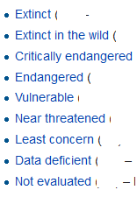
The following eight categories of species called Red List categories, have been recognized by the World Conservation Union. ( formerly IUCN)

Slide 19
Zoogeographical regions of India
On the basis of the type of fauna found in a region, India has been divided in several regions
Himalayan Region- yak gural, snow leopard
Malabar Region (south west –karnataka, kerala -monkeys, deers (moderate climate)
Nilgiri Region(western ghats and south India) - no. of birds, elephants and lions.
Northern Plains- leopards, neelgai, jackals, deer
Desert Lands-cheetals, sambars, neelgai, lizard.
Deccan Plateau Region(bw western ghat and eastern ghat - varieties of animals.

Slide 20
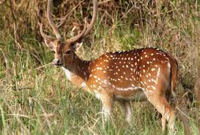
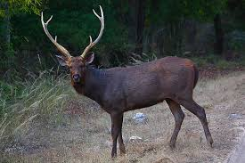
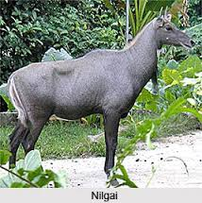

Slide 21
13. ___________ is defined as the number of species represented in a specific region, landscape or an ecological community.
Coevolution
Commensalism
Species richness
Population density
14. Global warming can significantly be controlled by _____________
Increasing solid waste
Reducing water wastage
Burning human-generated waste
Reducing fossil fuel consumption
15. _______ is the basic unit of classification and a taxonomic rank
Species
Genus
Class
Order
16. Which of the following animals is now extinct?
Tasmanian tiger
Tasmanian devil
Pademelon
Quoll

Slide 22
13. ___________ is defined as the number of species represented in a specific region, landscape or an ecological community.
Coevolution
Commensalism
Species richness
Population density
14. Global warming can significantly be controlled by _____________
Increasing solid waste
Reducing water wastage
Burning human-generated waste
Reducing fossil fuel consumption
15. _______ is the basic unit of classification and a taxonomic rank
Species
Genus
Class
Order
16. Which of the following animals is now extinct?
Tasmanian tiger
Tasmanian devil
Pademelon
Quoll

